Slide 1
Making Text for the Web part 3
Barb Ericson
Georgia Institute of Technology
March 2006

Slide 2
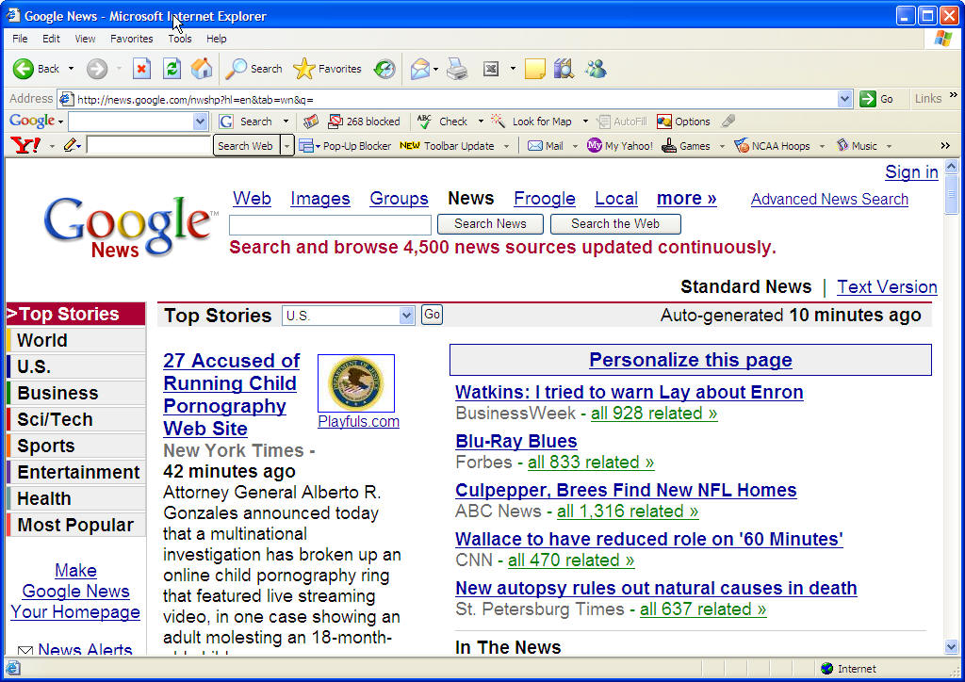
Using other Web Pages
Sites like Google news create web pages by getting information from other web pages

Slide 3
Adding the Current Temperature
Let's add the current temperature to a Homepage
Using the method getTempFromNetwork in class TempFinder
  This is an example of reuse
  Reusing working classes and methods is one of the advantages of object-oriented development

Slide 4
Adding Temp to a Homepage
public void writeHomepageV3(String name,
String interests)
{
// get the current temperature
TempFinder tempFinder = new TempFinder();
String urlString = "http://www.ajc.com/";
String currTemp = tempFinder.getTempFromNetwork(urlString);
// try the following
try {
// open a file for writing
BufferedWriter writer =
new BufferedWriter(new FileWriter(name + ".html"));
// write the start
writeStart(writer);
// write the header
writeHead(writer,name + "'s Homepage");
// write the body
writeBody(writer,"<h1>Welcome to " + name +
"'s Homepage</h1>" +
"<p> I am interested in " + interests +
".</p><p>Right now it is " + currTemp +
" degrees.</p>");
// end the page
writeEnd(writer);
// close the writer
writer.close();
} catch (Exception ex) {
ex.printStackTrace();
}
}

Slide 5
Testing the Addition of Temp
Use the following main method to test the new method
  In class WebPageWriter
public static void main(String[] args)
{
WebPageWriter writer = new WebPageWriter();
writer.writeHomepageV3("Mark", "reading");
}

Slide 6
The Unnamed Package
If you don't specify what package your class is in at the beginning of your class file
  Using the package xxx; statement before the class definition
It is put in the "unnamed" package
  A package without a name
Both WebPageWriter and TempFinder are in the "unnamed" package

Slide 7
Adding a Random Sentence
We can reuse the method generateRandomSentence in class SentenceGenerator too
  To add a random sentence to the generated Homepage
Simply create an object of the class SentenceGenerator
  And invoke the generateRandomSentence method
  And use the result in the HTML page

Slide 8
Add Random Sentence
public void writeHomepageV4(String name,
String interests)
{
// get the current temperature
TempFinder tempFinder = new TempFinder();
String urlString = "http://www.ajc.com/";
String currTemp = tempFinder.getTempFromNetwork(urlString);
// get the random sentence
SentenceGenerator sentenceGen = new SentenceGenerator();
String sentence = sentenceGen.generateRandomSentence();
// try the following
try {
// open a file for writing
BufferedWriter writer =
new BufferedWriter(new FileWriter(name + ".html"));
// write the start
writeStart(writer);
// write the header
writeHead(writer,name + "'s Homepage");
// write the body
writeBody(writer,"<h1>Welcome to " + name +
"'s Homepage</h1>" +
"<p> I am interested in " + interests +
".</p><p>Right now it is " + currTemp +
" degrees.</p>" +
"<p>The random thought for the day is: " +
sentence + "</p>");
// end the page
writeEnd(writer);
// close the writer
writer.close();
} catch (Exception ex) {
ex.printStackTrace();
}
}

Slide 9
Testing the Random Sentence
Use the following main method to test the new method
  In class WebPageWriter
public static void main(String[] args)
{
WebPageWriter writer = new WebPageWriter();
writer.writeHomepageV4("Letisha", "flying planes");
}

Slide 10
Walking through the Code
Execution starts in the main method
  Which creates a WebPageWriter object
  And then calls the writeHomepageV4 method
    Passing in copies of the references to the string objects "Letisha" and "flying planes"
The writeHomepageV4 method executes
  With a name variable referring to "Letisha" and the interests variable referring to "flying planes".
An object of class TempFinder is created
  the method getTempFromNetwork is used to get the temperature from http://www.ajc.com/
An object of the class SentenceGenerator is created
  the method generateRandomSentence is used to return a random sentence as a String object

Slide 11
Walking through the code (Continued)
Execution continues in the try block
  We try to create a BufferedWriter object using a FileWriter object created from a file with the passed in name and ".html"
  The method writeStart is called
  The method writeHead is called
  The method writeBody is called
    With a string that includes the current temperature and a random sentence
  The method writeEnd is called
  We close the BufferedWriter to finish writing to the file
If an exception occurs during the execution of any code in the try block then the catch block will execute
  And the stack trace will be printed

Slide 12
Exercise
Write a class that gets some information from a Web page
  Such as the top headline on www.cnn.com
  Or sport scores
  Or stock values
Create a homepage that includes that class to get the information and displays it in the homepage

Slide 13
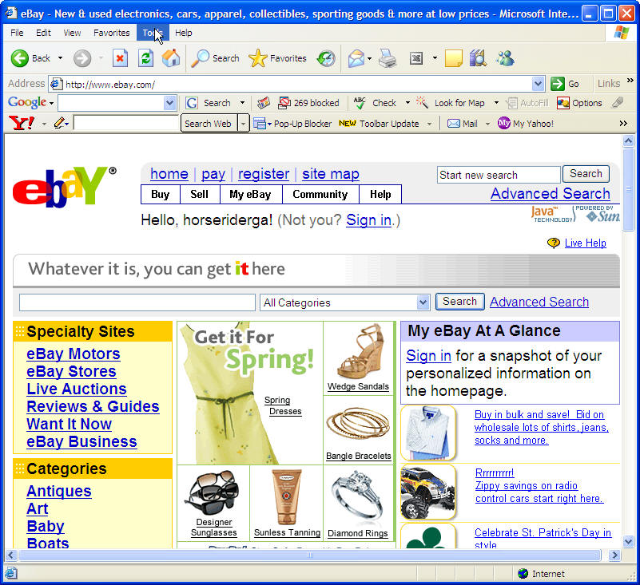
Databases
Many Web sites use databases to store information
  And then dynamically generate HTML pages from information in the database
    Based on user input
  eBay, Amazon, Google, Delta, etc

Slide 14
Why Use Databases?
They are fast
  Use indices to find information quickly
    Like finding a name in a phone book
They can store lots of data
  Google uses databases to answer search queries
  Walmart has huge databases of products and sales
They are standard
  Use the same language to put data in and get it out
    Even from different databases (Access, Oracle, mySQL)
They allow many people access to the data
  Distributed access over network

Slide 15
Storing Related Data
Most databases are relational databases
  They store related data in tables
  The table on right shows an implied relationship between a person and a number (age)
Mark | 43
Matt | 14
Sharquita | 30
Edgar | 42

Slide 16
Summary
You can read data from one Web page
  And use it in another web page
  Like Google News
Databases are used to store large amounts of data
  In tables with related data in the same row of the table
  So that many people and programs can access the data

